Slide 1
Lecture 17: Hazardous Wastes, CERCLA, and RCRA
Prof. Austin
Environmental Economics Econ 475

Slide 2
Part 1: Comprehensive Environmental Response, Compensation, and Liability Act

Slide 3
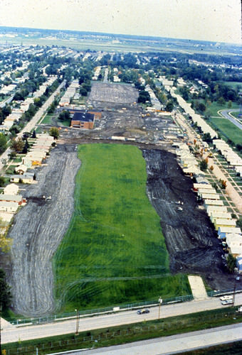
Love Canal, NY
Elementary School
Original site of a potential canal connecting upper and lower Niagara Rivers.
Hooker Chemical Company waste dumping site for lindane, chlorobenzenes, acid chlorides, and many other chemicals.
Miscarriages, half of children had birth defects, one third of residents had chromosomal damage.
221 families relocated
$275m in cleanup costs.
Former Canal Site
Figure: Aerial image of the Love Canal community (source).

Slide 4
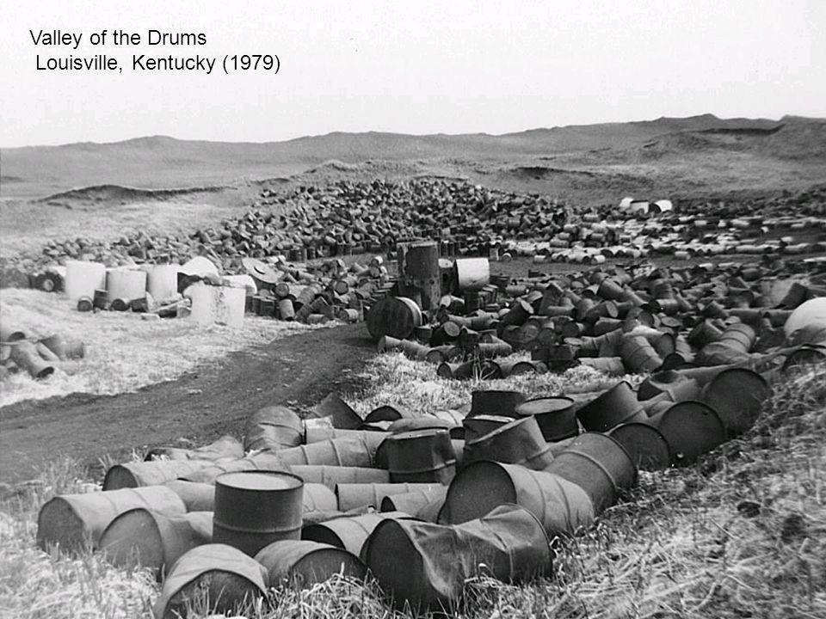
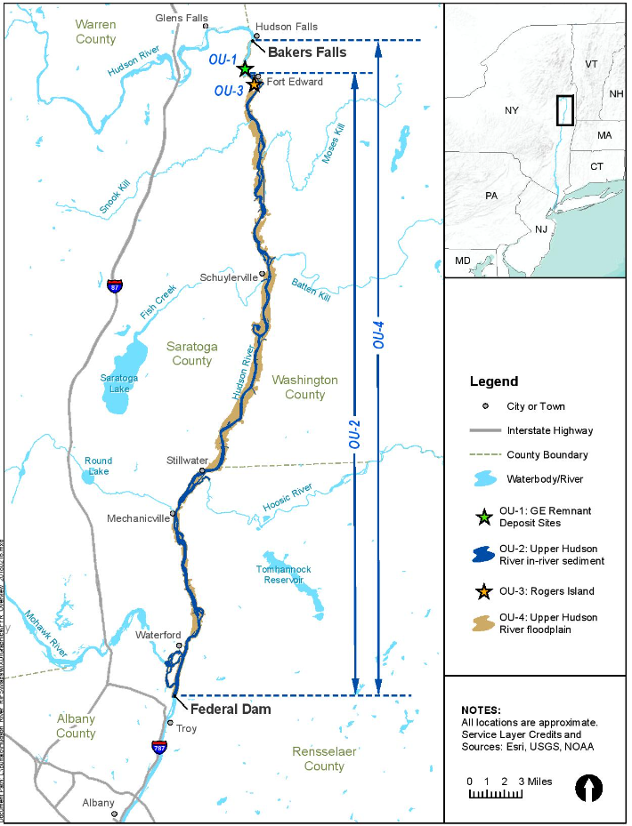
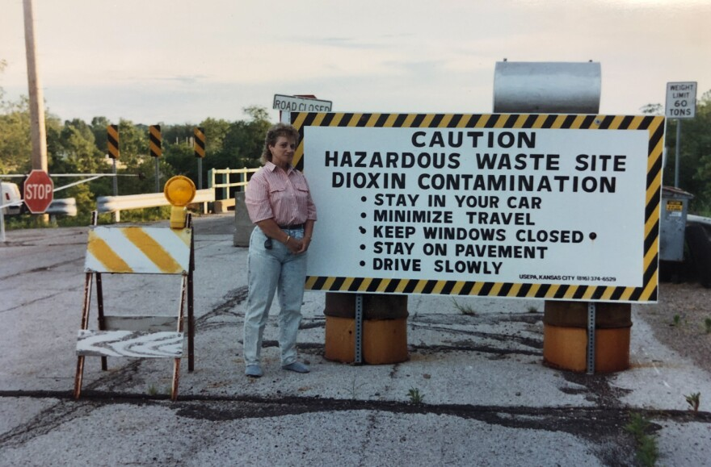
Motivation for CERCLA
Many others:
The Hudson River (PCBs)
Times Beach, MO (dioxins) - (image link)
Valley of the Drums, KY (heavy metals)
Figure: General Electric (GE) dumped 1.3 million tons of PCBs into the Hudson river over 30 years until 1977.

Slide 5
CERCLA and the Superfund Program
Three key pieces to CERCLA:
Identify hazardous waste sites, characterize their toxicity, and place some on a National Priorities List (NPL).
Establishment of a fund (i.e., the “Superfund”) to clean up these sites in a timely manner.
Originally, fund was created with a tax on oil refineries and chemicals producers, which was dropped and then re-instated in 2021.
Allows the government, states, or private entities to recover cleanup costs from the release or potential release of hazardous substances from Potentially Responsible Parties.

Slide 6
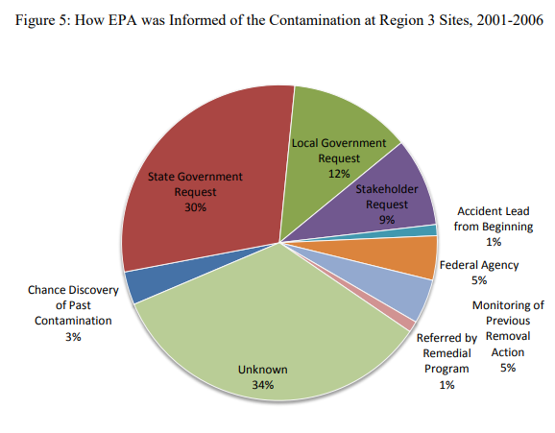
The Superfund Timeline to Full Cleanup
Steps leading up to clean-up:
A site is reported to the National Response Center (24/7 call line) and then proposed as a site (“proposal”)
Preliminary investigation and site assessment
National Priorities Listing (“listing”)
Remedial investigation and cleanup feasibility study
Design of remediation action and Record of Decision (ROD) for the plan
Remedial cleanup construction (“construction”)
Eventually, de-listing (“deletion”)
Source: Jenkins et al. (2011).

Slide 7
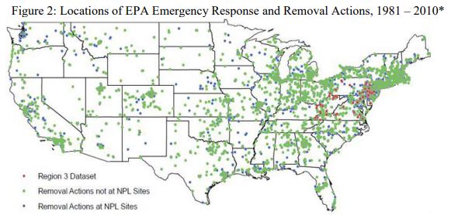
Two Types of Actions
Depending on the nature of the site, there are two types of action that may be taken:
Removal actions: Immediate short-term responses to an emergency spill or ongoing urgent threat to public health. Much more common but less well-known incidents.
Remedial actions: Longer-term response to complex sites with multi-year investigation, detailed planning, public comment periods, and eventual clean-ups.
Source: Jenkins et al. (2011).

Slide 8
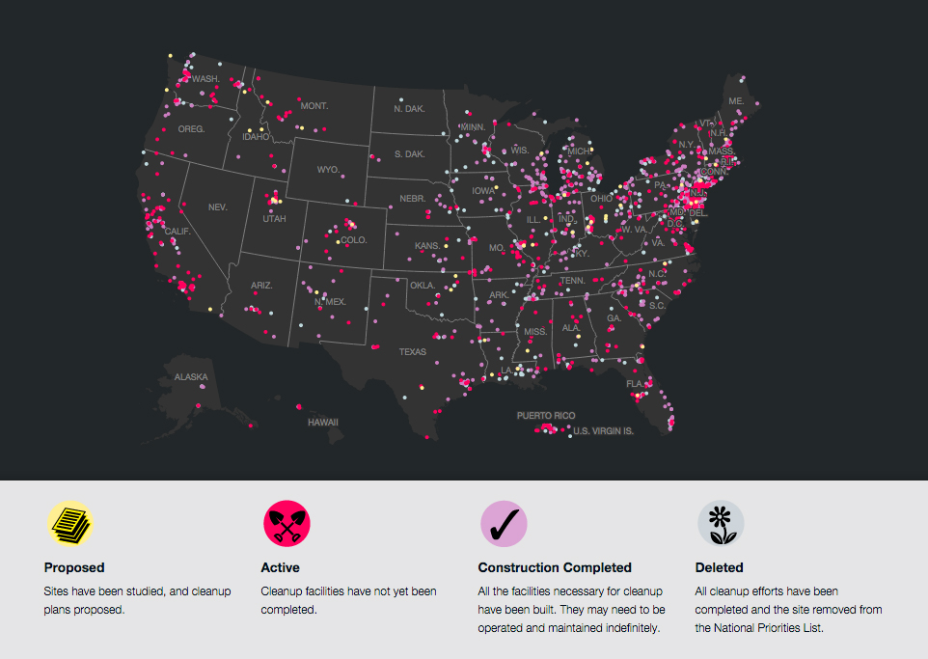
National Priorities Listing
During site assessment:
Locations receive a Hazard Ranking Score (HRS).
Sites with a HRS above 28 are placed on the National Priorities List.
1,700 NPL sites created from 47,000 investigations.
Currently there are 1337 NPL sites, and 392 have been de-listed.
Source: National Geographic (2014)

Slide 9
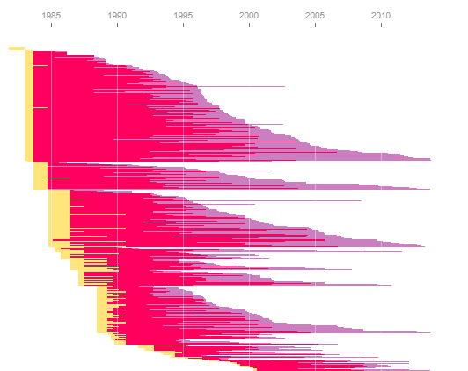
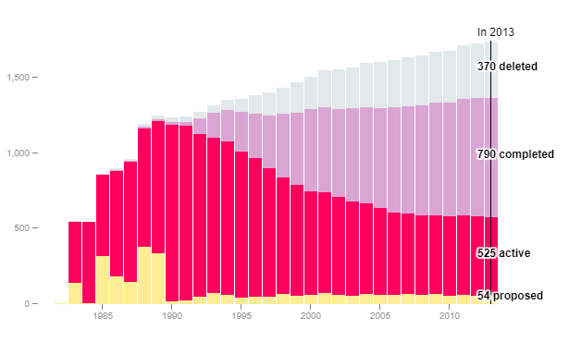
Timeline for NPL De-listing
It can take a long time to complete clean-up…
Source: National Geographic (2014)

Slide 10
Potentially Responsible Parties (PRPs)
CERCLA allows compelling that cleanup payments be recovered from or made by potentially responsible parties.
Liability is joint across all polluting parties although costs are not divided equally
Firms or operators of facilities that generated the hazardous substance
Firms that transported the pollution to or from the site
Firms that stored the pollution
Cleanup liability is strict (i.e., fault-based vs. no-fault liability)
Liability is fully retroactive
Cannot escape liability by paying another firm to get rid of the waste or subsidiarizing the pollution.

Slide 11
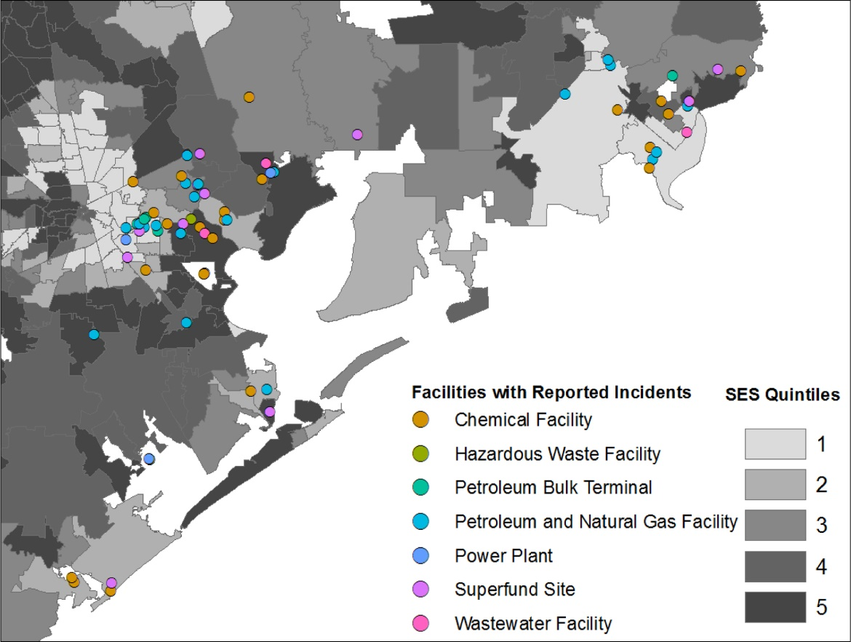
Some Limits to CERCLA Liability
Figure: Hurricane Harvey Accidents Near Houston
Strict liability except in a few cases:
Nearby landowners
Acts of a third-party
Extreme acts of nature
Acts of war
Source: Lieberman-Cribbin et al. (2021).

Slide 12
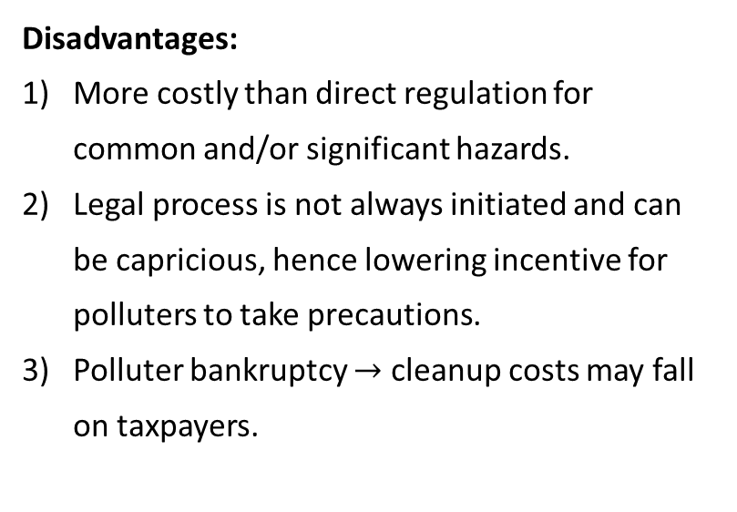
Liability as a Regulatory Instrument
Advantages:
Low cost if minimal risk and infrequent accidents.
More decentralized than direct regulation, hence lower information requirements for the regulator.
Disadvantages:
More costly than direct regulation for common and/or significant hazards.
Legal process is not always initiated and can be capricious, hence lowering incentive for polluters to take precautions.
Polluter bankruptcy $→$ cleanup costs may fall on taxpayers.

Slide 13
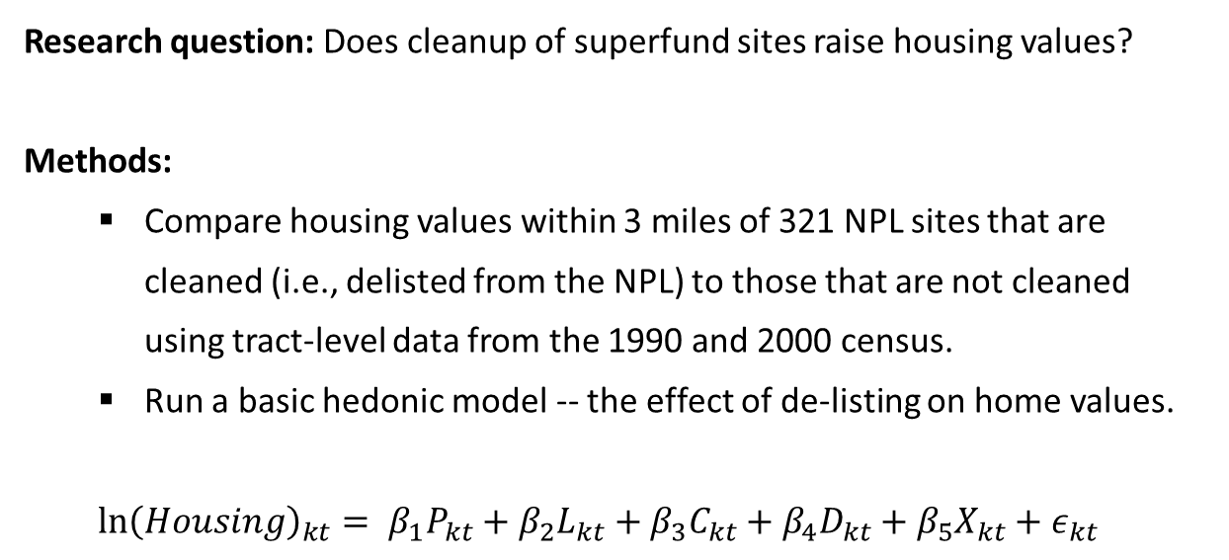
Gamper-Rambindran and Timmins (2013)
Research question: Does cleanup of superfund sites raise housing values?
Methods:
Compare housing values within 3 miles of 321 NPL sites that are cleaned (i.e., delisted from the NPL) to those that are not cleaned using tract-level data from the 1990 and 2000 census.
Run a basic hedonic model -- the effect of de-listing on home values.
$$\ln{{\left(Housing\right)}_{kt}}= β_{1}P_{kt}+β_{2}L_{kt}+β_{3}C_{kt}+β_{4}D_{kt}+β_{5}X_{kt}+ε_{kt}$$

Slide 14
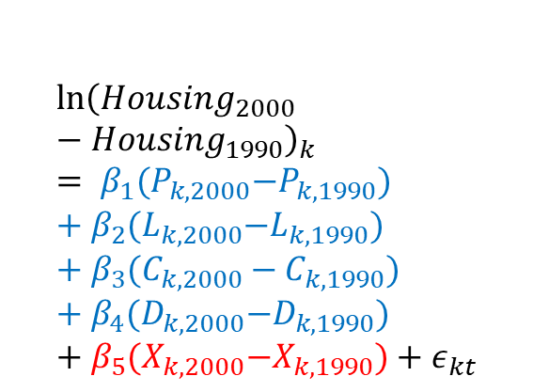
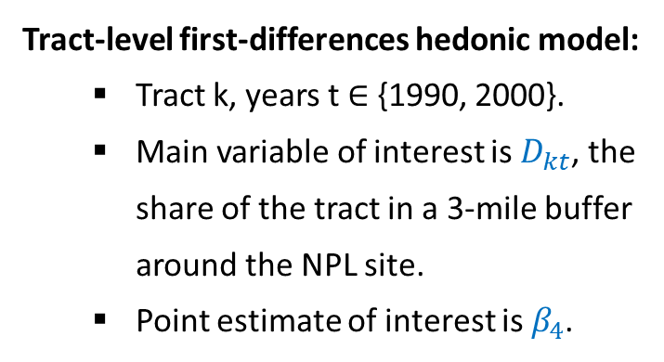
Gamper-Rambindran and Timmins (2013)
Variables for steps in the superfund process (proposal, listing, construction, de-listing).
Tract-level first-differences hedonic model:
Tract k, years t $∈$ {1990, 2000}.
Main variable of interest is $D_{kt}$, the share of the tract in a 3-mile buffer around the NPL site.
Point estimate of interest is $β_{4}$.
$$\ln{{\left(Housing_{2000}−Housing_{1990}\right)}_{k}}= β_{1}{(P}_{k, 2000}−P_{k,1990})+β_{2}{(L}_{k,2000}−L_{k,1990})+β_{3}(C_{k,2000}−C_{k,1990})+β_{4}{(D}_{k,2000}−D_{k,1990})+β_{5}{(X}_{k,2000}−X_{k,1990})+ε_{kt}$$
Housing stock, socioeconomic, and demographic characteristics of the tract.

Slide 15
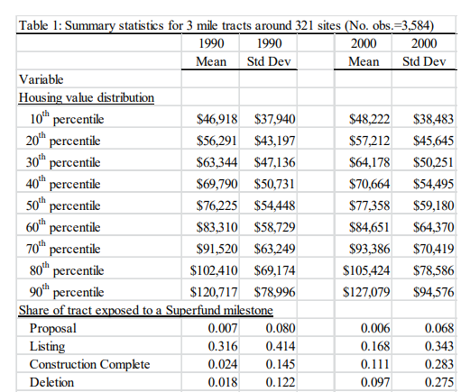
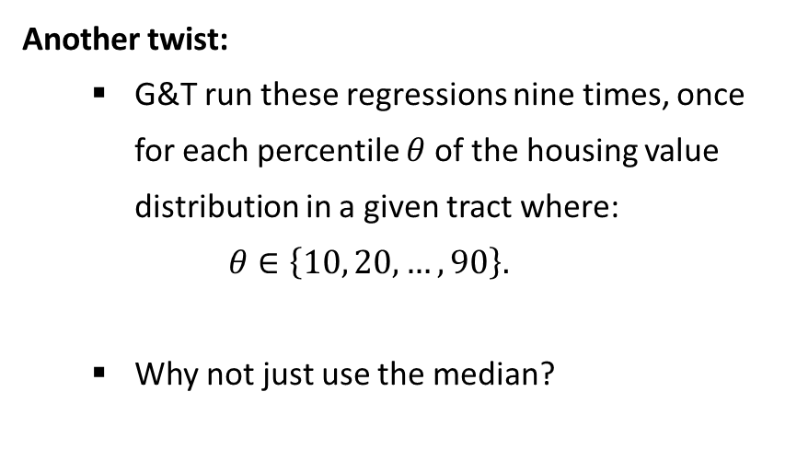
Gamper-Rambindran and Timmins (2013)
Another twist:
G&T run these regressions nine times, once for each percentile $θ$of the housing value distribution in a given tract where:
$$θ∈\left\{10, 20,…,90\right\}.$$
Why not just use the median?

Slide 16
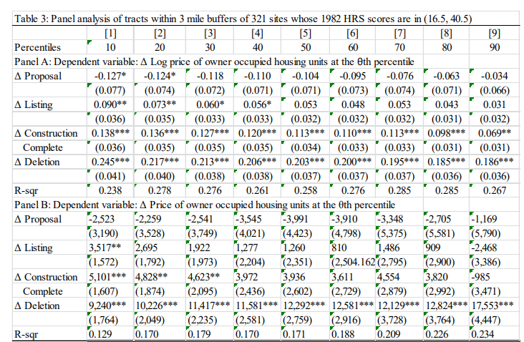
Gamper-Rambindran and Timmins (2013)
Findings:
1) Proposing a site for the NPL list is associated with significant decreases in home values for the lowest-valued homes.

Slide 17
Gamper-Rambindran and Timmins (2013)
Findings:
2) Listing a site on the NPL is associated with significant increases in home values, with increases being more evenly spread across homes in the bottom half of the value distribution.

Slide 18
Gamper-Rambindran and Timmins (2013)
Findings:
3) Finishing construction of the remediation plan on an NPL site is also associated with significant increases in home values across the value distribution.
Increases are largest in magnitude for homes with the lowest baseline values.

Slide 19
Gamper-Rambindran and Timmins (2013)
Findings:
4) Deletion from the NPL list dramatically increases home values, by 19-25% depending on the starting values.
Increases are largest in magnitude for homes with the largest baseline values, but proportionally are largest for lowest-valued homes.

Slide 20
Gamper-Rambindran and Timmins (2013)
Summary of findings and take-away:
Large impacts of completing construction of remediation on home values, larger impacts from deletion from the NPL.
Benefits are the sum of the housing value changes for each decile times the tract-level number of houses divided by ten.
Average benefits per site are $72 million, average costs are $9 million.
Benefits > Costs for 35 out of 55 sites…

Slide 21
Other Benefits of Cleanup: Persico, Figlio, and Roth (2020)
Research goal: Examine the long-term effects of prenatal exposure to environmental toxics from Superfund sites on observable outcomes in restricted-use education data. Research setting:
8% of Florida students born from 1994-2002 live within 2 miles of a Superfund site.
These students also have K-12 education records.
Methods: Compare siblings living within 2 miles of an NPL site who faced different toxic exposures during gestation because of Superfund site cleanup.

Slide 22
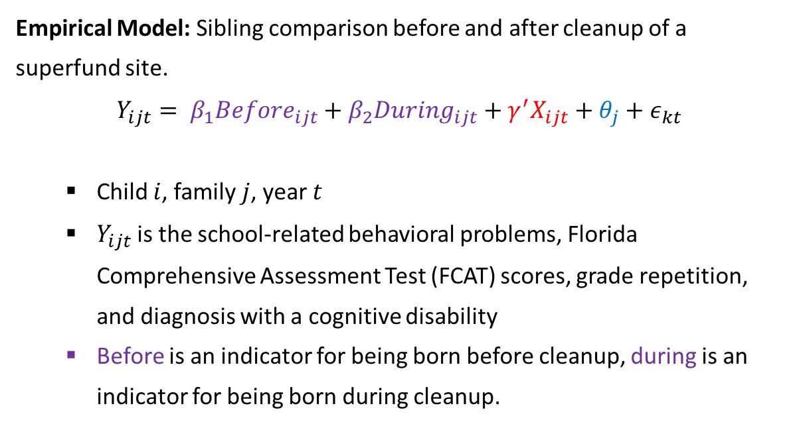
Persico, Figlio, and Roth (2020)
Empirical Model: Sibling comparison before and after cleanup of a superfund site.
$$Y_{ijt}= β_{1}Before_{ijt}+β_{2}During_{ijt}+γ^{′}X_{ijt}+θ_{j}+ε_{kt}$$
Child $i$, family $j$, year $t$
$Y_{ijt}$is the school-related behavioral problems, Florida Comprehensive Assessment Test (FCAT) scores, grade repetition, and diagnosis with a cognitive disability
Before is an indicator for being born before cleanup, during is an indicator for being born during cleanup.
Family fixed effect
Controls for gender, birth year, birth month, birth spacing, and birth order

Slide 23
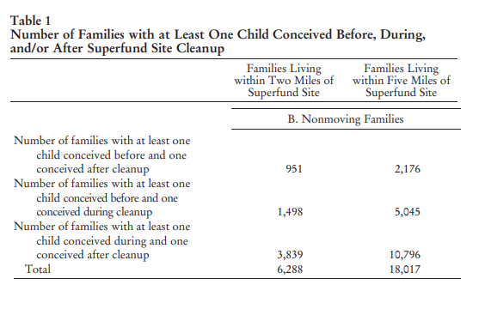
Persico, Figlio, and Roth (2020)
Other considerations:
Potential for effects of toxic chemicals exposure to endure after cleanup.
Avoidance behaviors could bias any results to zero.
Unknown mechanism of exposure across sites.
Cleanup takes a long time, so the sample is relatively limited.

Slide 24
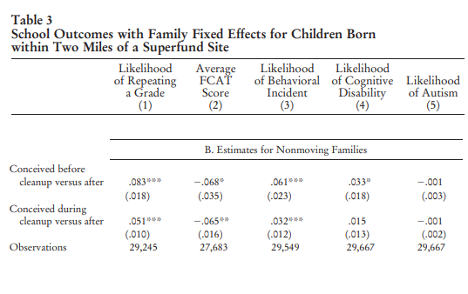
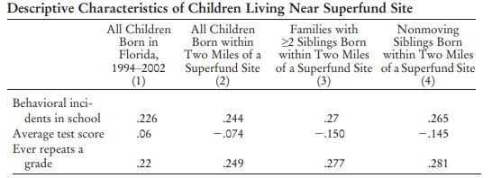
Persico, Figlio, and Roth (2020)
Children born before cleanup, in comparison to siblings born after cleanup, are significantly more likely to:
Repeat a grade
8.3 percentage points more likely
Score lower on standardized tests
Effect is one half the impact of being in a small class in Kindergarten.
Have more behavioral incidents
Be diagnosed with a cognitive disability

Slide 25
Persico, Figlio, and Roth (2020)
Children born before cleanup, in comparison to siblings born after cleanup, are significantly more likely to:
Repeat a grade
8.3 percentage points more likely
Score lower on standardized tests
Effect is one half the impact of being in a small class in Kindergarten.
Have more behavioral incidents
Be diagnosed with a cognitive disability

Slide 26
Persico, Figlio, and Roth (2020)
Children born before cleanup, in comparison to siblings born after cleanup, are significantly more likely to:
Repeat a grade
8.3 percentage points more likely
Score lower on standardized tests
Effect is one half the impact of being in a small class in Kindergarten.
Have more behavioral incidents
Be diagnosed with a cognitive disability

Slide 27
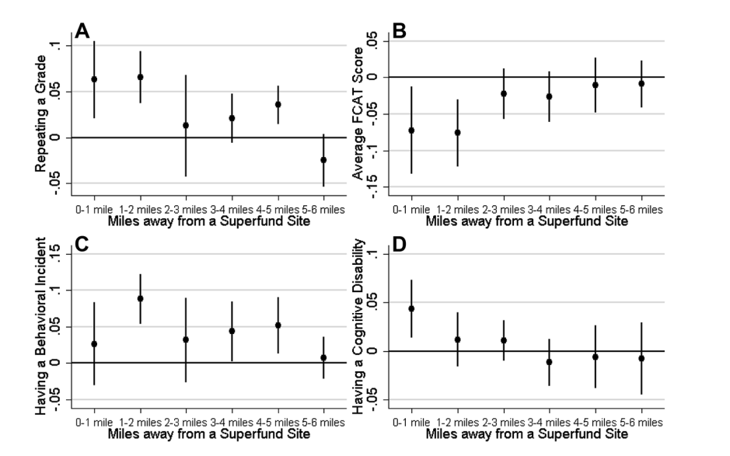
Persico, Figlio, and Roth (2020)
Other notable findings:
Results are not necessarily limited to within three miles of a Superfund site.
80 million Americans live within 3 miles of a Superfund site, and 11 million live within one mile.

Slide 28
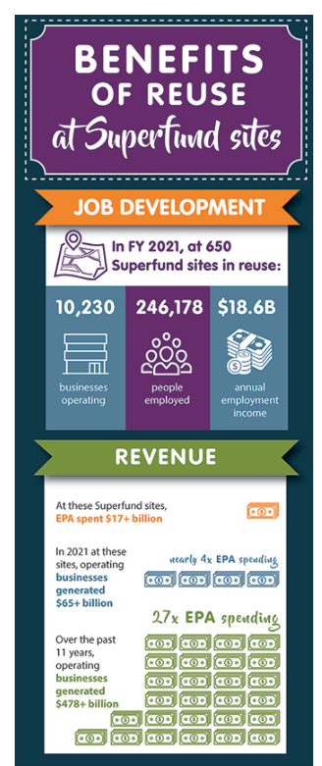
Other Impacts of Cleanup
EPA has spent nearly $17 billion to clean up roughly 650 Superfund sites since the start of the program. Now, these sites:
Support over 10,000 businesses with total annual sales of more than $63 billion.
These businesses employed over 245,000 employees taking home $18 billion in income annually.
Source: EPA, 2022.

Slide 29
CERCLA in the News: Designation of PFAS as a Hazardous Substance
EPA is proposing to designate PFOA and PFOS as hazardous substances.
You can submit a public comment on the proposed regulation here.
A hazardous substance designation would mean that sites contaminated with these chemicals could become Superfund sites, with resulting cleanup and liability.
As many as 44,000 new sites would be investigated.
Some notable opposition from industry (see Chamber of Commerce report).

Slide 30
Part 2: Resource Conservation and Recovery Act
Notes:
Next time cover Denny’s paper on TSDFs.
https://econ.appstate.edu/RePEc/pdf/wp2107.pdf

Slide 31
RCRA Overview
The Resource Conservation and Recovery Act (RCRA), which existed before the Superfund program, provides minimum standards for land storage of waste.
It was the “... last remaining loophole in environmental law, that of unregulated land disposal of discarded materials and hazardous wastes” (Jenkins et al. 2008).
Subtitle D, Hazardous Waste: “cradle-to-grave” requirements on hazardous waste management.
Subtitle C, Nonhazardous Waste: Minimum standards for landfills and recycling programs

Slide 32
RCRA: Subtitle D
Largely based on the first hazardous waste control act written by California, RCRA:D establishes many requirements for hazardous waste management:
Defines hazardous waste.
Specific listed chemicals OR any substance that exhibits toxicity, ignitability, corrosivity, or reactivity.
Tracking and reporting of all wastes from cradle to grave.
Transport, storage, and disposal procedure requirements.
New waste management industry: Treatment, Storage, and Disposal (TSD) facilities

Slide 33
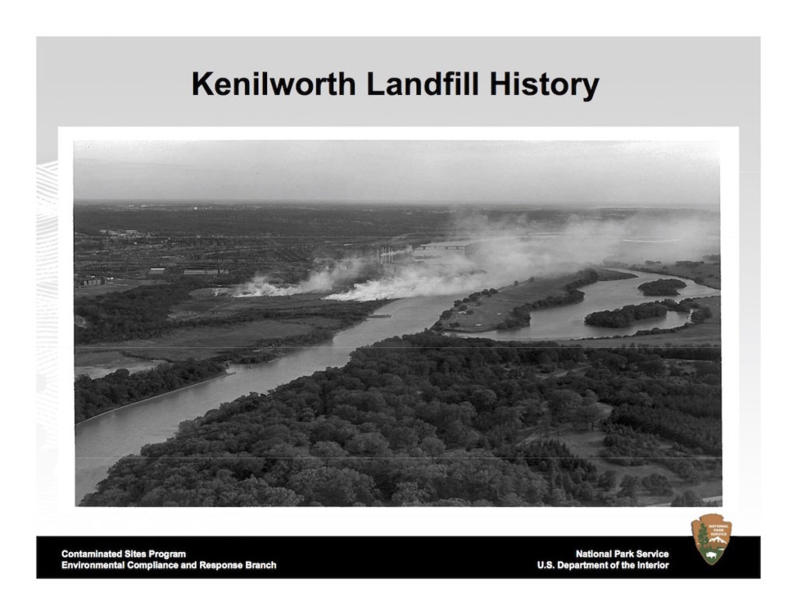
RCRA: Subtitle C
Increased landfill requirements:
Eliminated open dumping and open burning of waste.
Closed nearly 900 landfills and led to increasing concentration in the waste management industry.
Recycling and trash programs delegated to states, resulting in a wide variety of program types.
The Kenilworth Dump in DC allowed open burning for decades. Source.

Slide 34
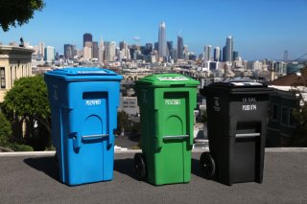
Experimentation in Waste Management
Some market-based examples:
Front-end disposal charges
Examples: Plastic bag fees, car batteries.
Deposit refund schemes
Examples: Soda cans, car batteries. Essentially works like an abatement subsidy or pollution tax.
Cash for trash programs
Examples: Seattle, Austin TX, Portland ME, all have “pay as you throw” strategies
Increased composting, recycling, and trash compacting. Might have increased illegal dumping by 28-43% (Fullerton, 1996).
Mandatory three-stream waste collection in San Francisco diverts 80% of waste (EPA, 2021).

Slide 35
Part 3: Case Study #3 PFAS NPDWR

Slide 36
What Are Per- and Polyfluoroalkyl Substances (PFAS)?
PFAS refers to a large class of synthetic chemicals.
Chains of carbon atoms surrounded by fluorine atoms.
Used in homes, businesses, and industry since the 1940s.
Detected in soil, water, and air samples.
Most people have been exposed to PFAS.
Resist decomposition in the environment and in the human body (“forever chemicals”).
Known or suspected toxicity.
Potential developmental, reproductive, liver, immune, thyroid, cardiovascular, and kidney effects.
Some are relatively well understood; many others are not.

Slide 37
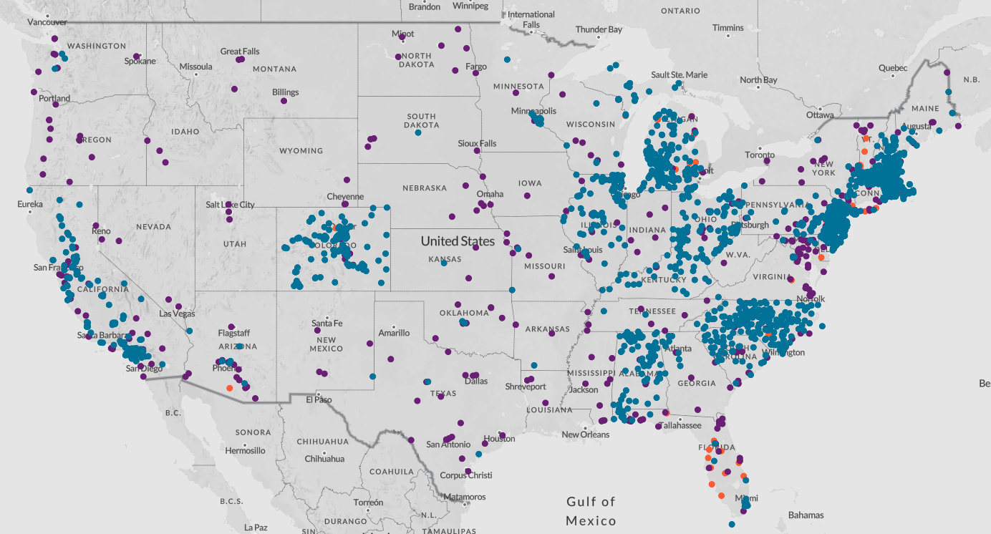
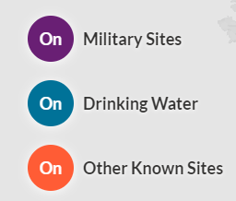
Environmental Working Group’s PFAS Interactive Map

Slide 38
Next class
Next class will cover the topic of regulating cars.
A reading and optional podcast for Wednesday:
Killeen and Levinson (2017)
Regan Patterson Transportation Justice podcast

